Slide 1
Machine Learning Project
Fire and smoke detection on CCTV camera video
Group 1
Intonti Giovanni
Squitieri Beniamino
Vitale Antonio

Slide 2
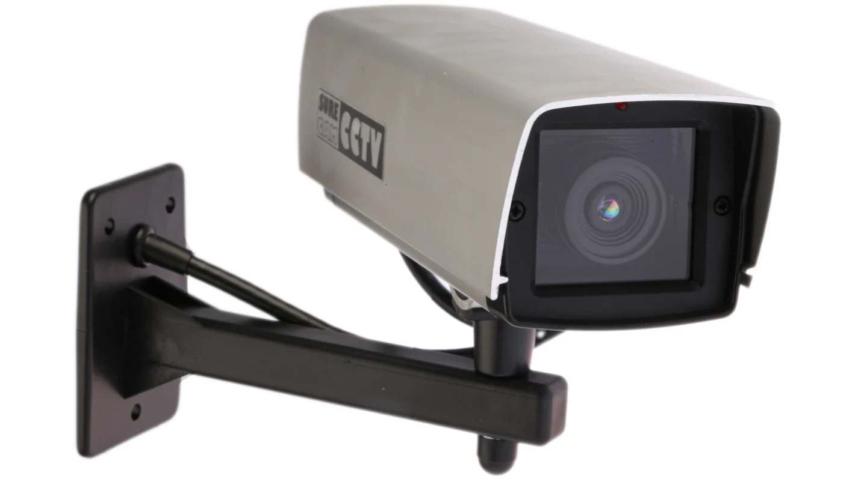
Goals and drescription of the project
“Classify a sequence of frames as either Positive (fire) or Negative (no fire)”
Types of videos
Type of classification
Metrics
Static camera, mostly CCTV camera videos
True Positive
True Negative
False Positive
False Negative
1
Precision
Training Set
2
Recall
312 videos spllited in two classes:
FIRE
NO FIRE
3
F-Score

Slide 3
Choice of the network (SlowFast50r)
SlowPath/FastPath | The main idea of ​​a SlowFast network is to have two separate data streams, one "slow" and one "fast“, to capture both spatial and temporal information present in the videos.
Already classification of fire | Despite having been trained for the recognition of human actions, preliminary tests on the videos provided have revealed the ability of the network to recognize some classes of belonging such as: "exstinguish fire", "cooking on campfire" and "juggling fire“.
Transforms | UniformTemporalSubsample
 | Lambda (/255)
 | NormalizeVideo
Transforms | ShortSideScale
 | CenterCropVideo
 | PackPathway
Preprocessing | Resize function
Augmentation | ColorJitter, GaussianBlur, HorizontalFlip, RandomBrightnessContrast, HueSaturationValue

Slide 4
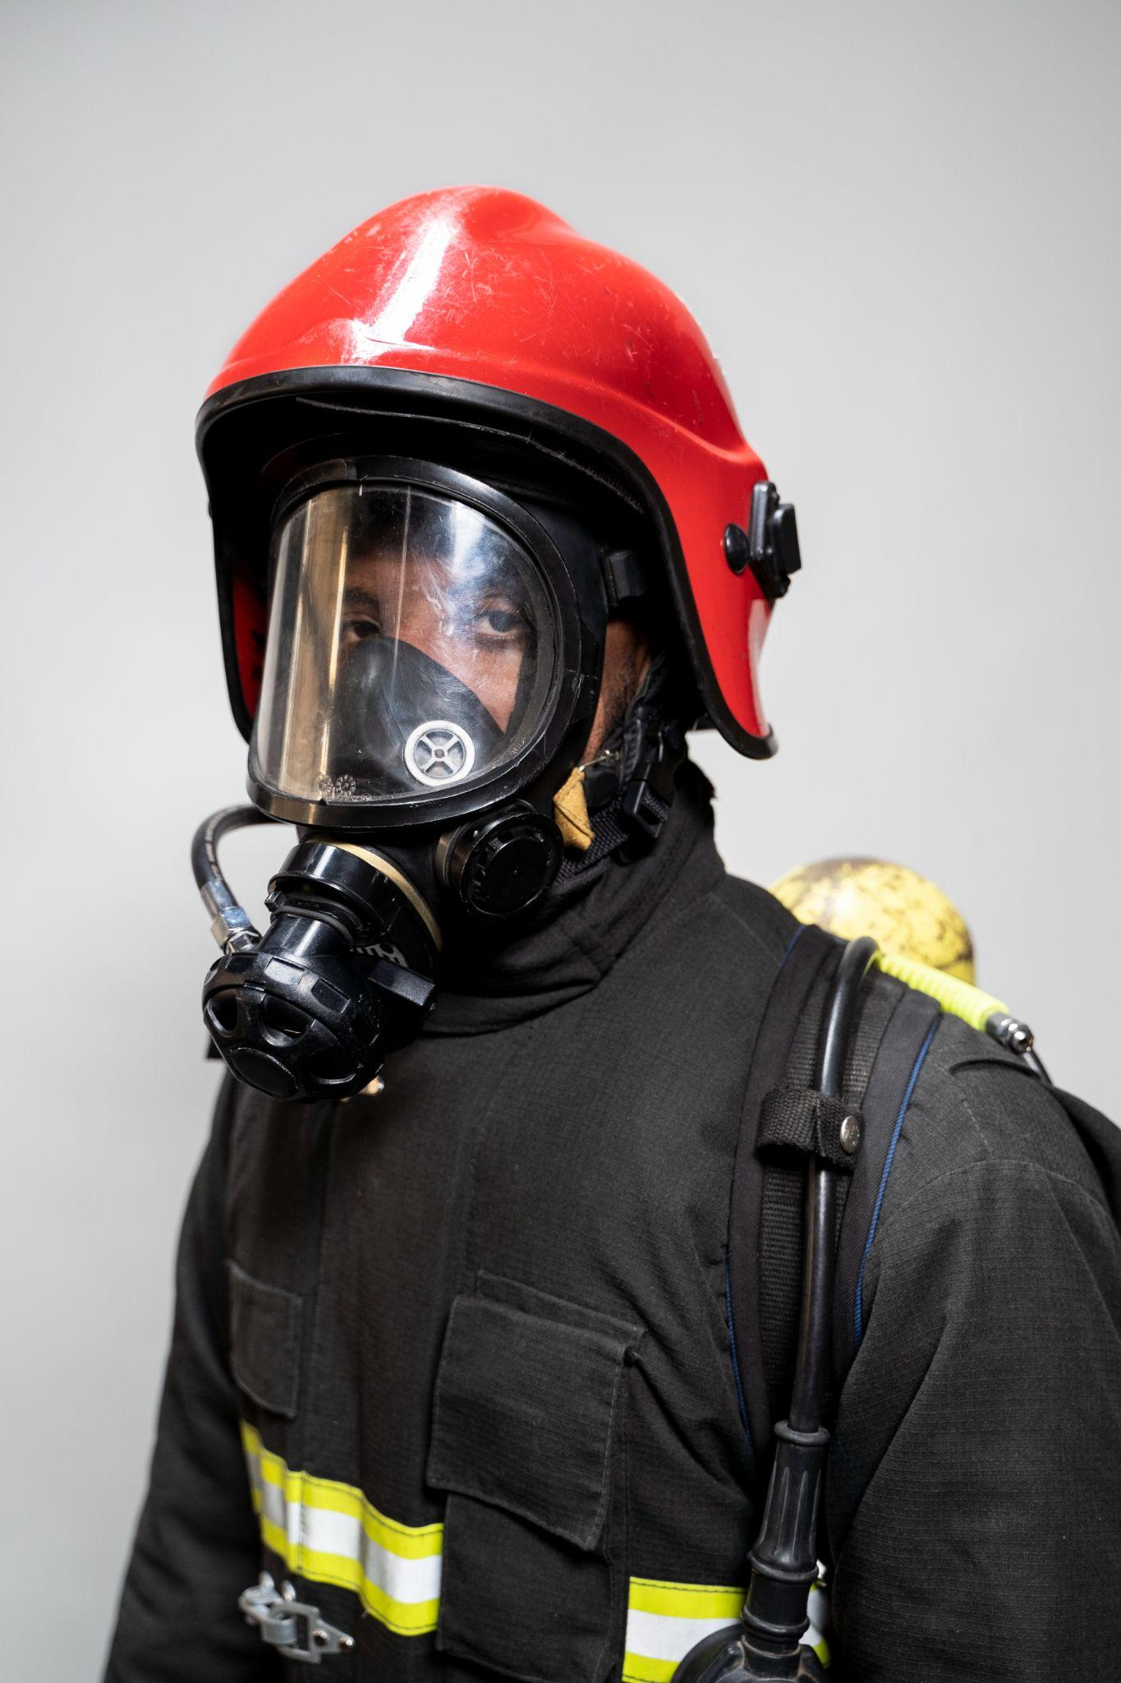
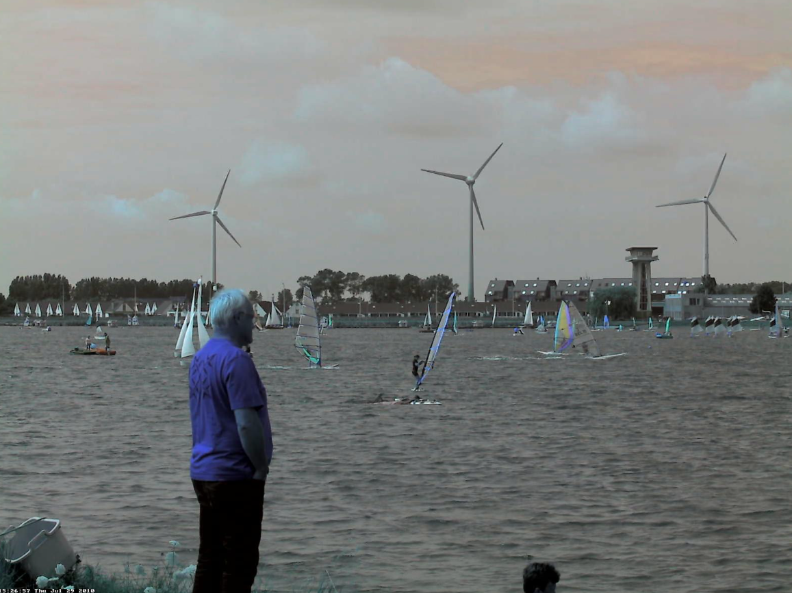
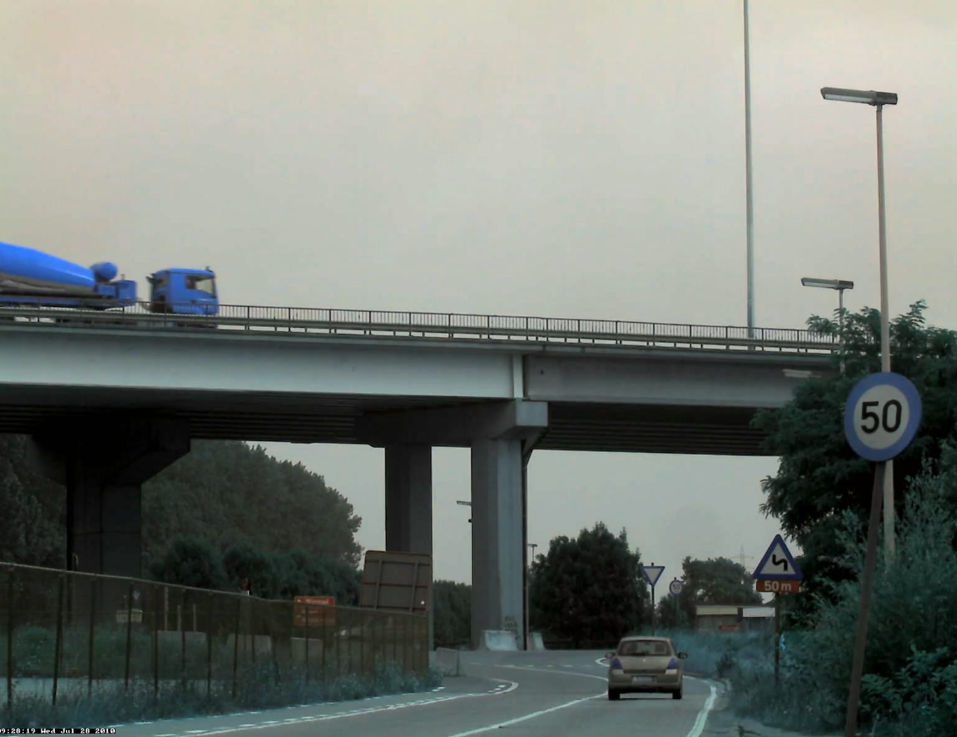
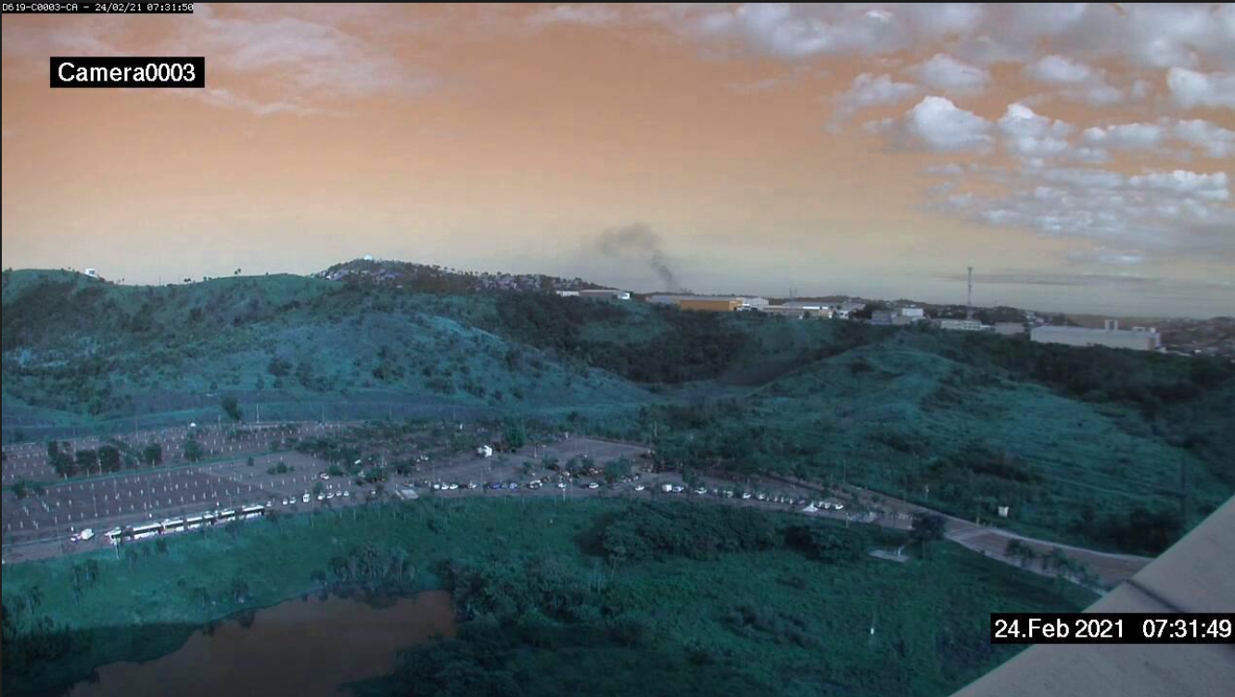
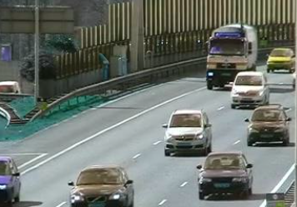
Visualizzazione dei dati

Slide 5
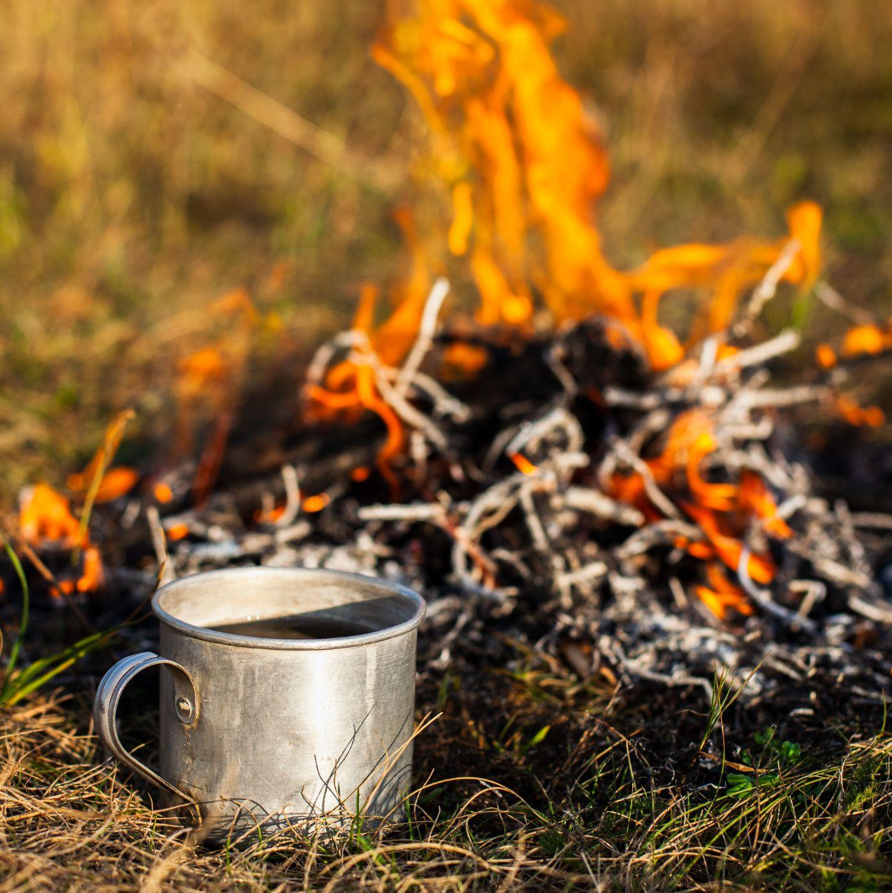

Crop Problem
With a crop performed in a central way there is the possibility that it completely removes the fire/smoke from the processed video, thus causing a false learning of the network of the video in question which, labeled with class 1, it will not have fire or smoke inside. Given the following analysis it was decided to remove this transformation, and to perform a Resize of the image, rather than a crop, so as to keep all the original information of the video, aware of the fact that the network has not been driven in this way.

Slide 6
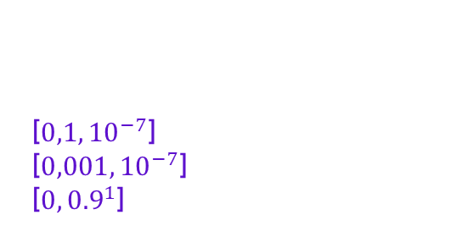
Start of Training and parameter choices
1
[${0,1, 10}^{−7}$]
[${0,001, 10}^{−7}$]
[${0, 0.9}^{1}$]
Learning Rate
Weight Decay
Momentum
2
3

Slide 7
First Results

Slide 8
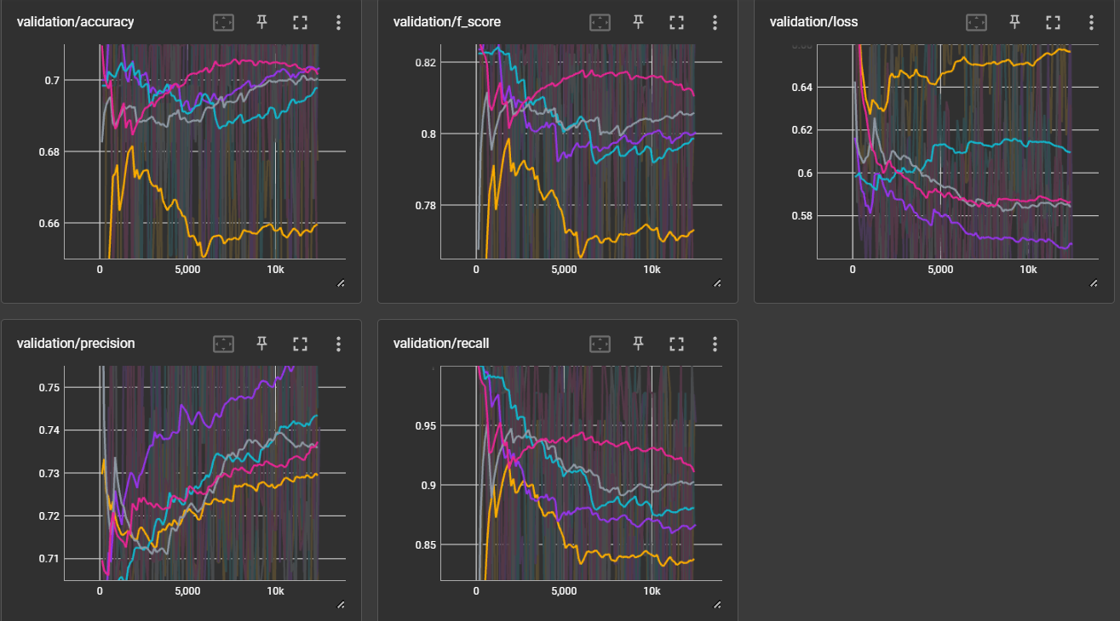
Crop Tries
Bad Validation Loss
Bad Level of Accuracy
Learning_rate = 0.1
Weight_decay = 0.00001
Momentum = 0.9
Batch_size = 2
Epochs = 100
Not enough value of precision
Good value of recall (for a bad reason)

Slide 9
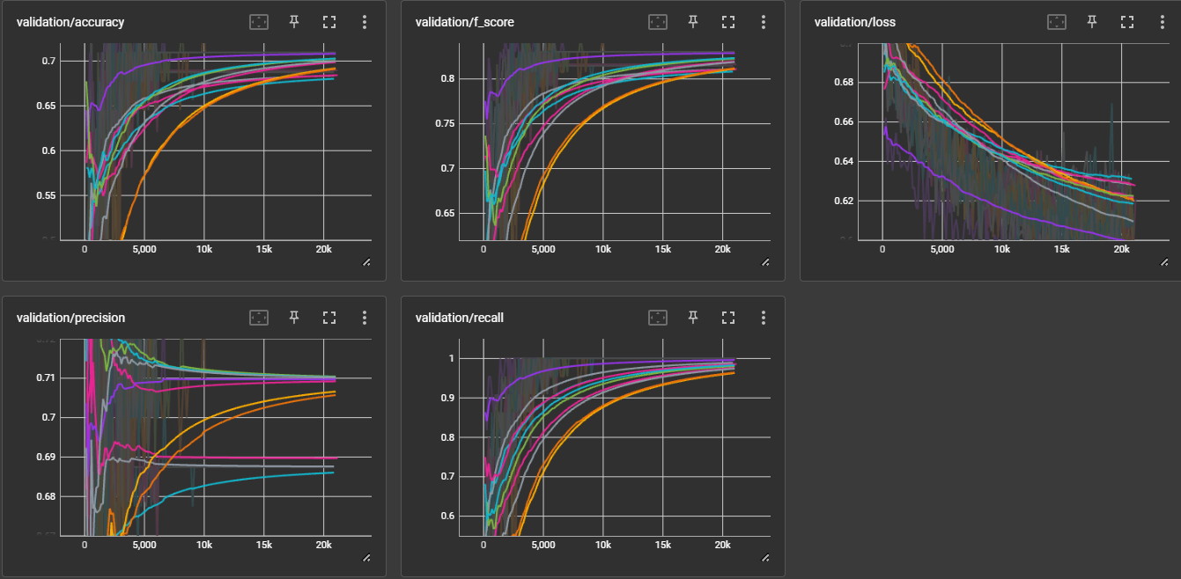
Resize Tries
Loss going down, but badly
Bad Level of Accuracy
Learning_rate = 0.0001
Weight_decay = 0.00001
Momentum = 0.9
Batch_size = 2
Epochs = 100
Not enough value of precision
Good value of recall (for a bad reason)

Slide 10
False Positive Problem
The initially supplied dataset presented a video ratio with/without flames or smoke of 70/30. This difference led the network, under the various parameters chosen, to favor the choice of always indicating any frame as fire. The results obtained, therefore, were unsatisfactory, given the presence of false positives for each negative sample present.

Slide 11

Balancing the Dataset + Class Weights

Slide 12
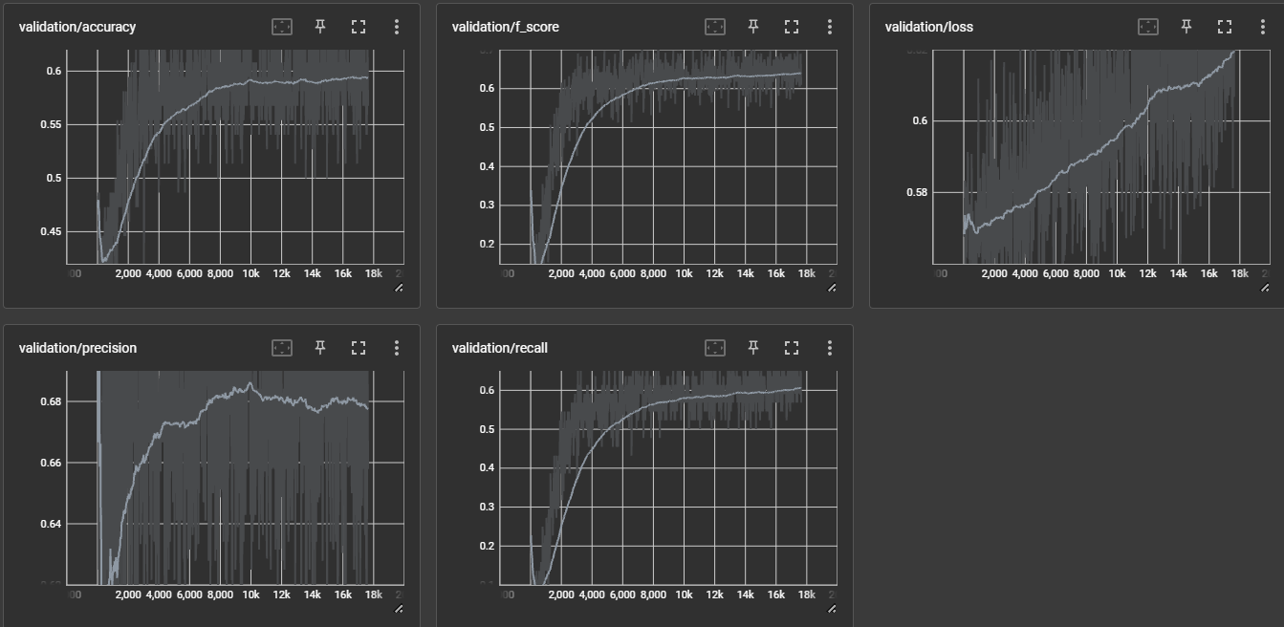
Testing the new dataset (Resize)
Overfitting
Bad Level of Accuracy
Learning_rate = 0.0001
Weight_decay = 0
Momentum = 0
Batch_size = 16
Epochs = 125
Not enough value of precision
Bad Value of Recall

Slide 13
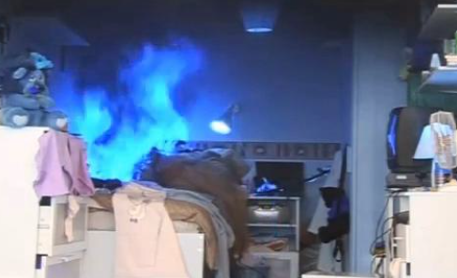
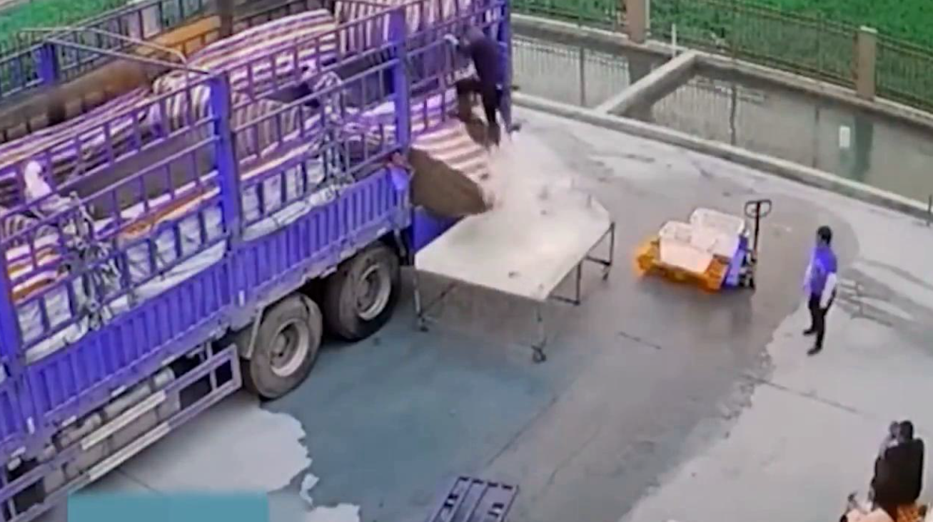
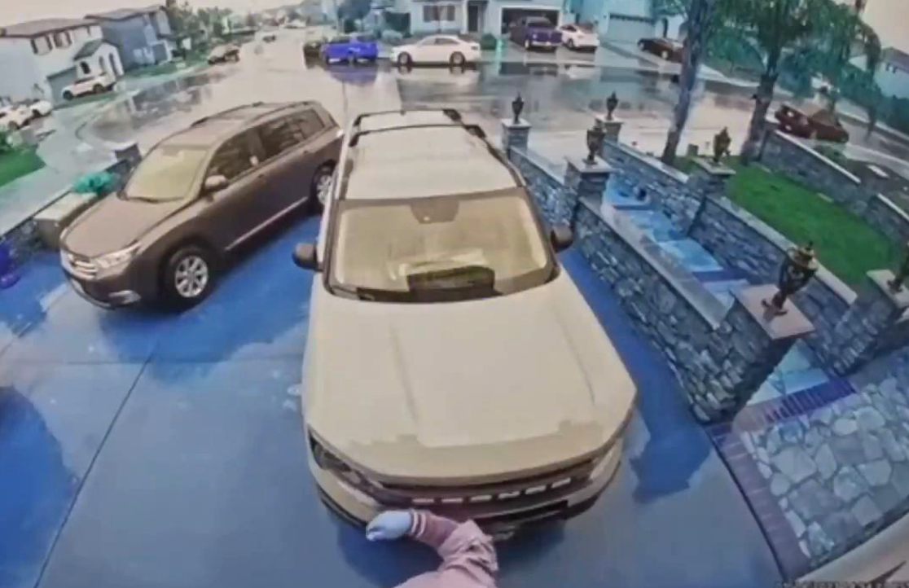
Dataset Augmentation

Slide 14
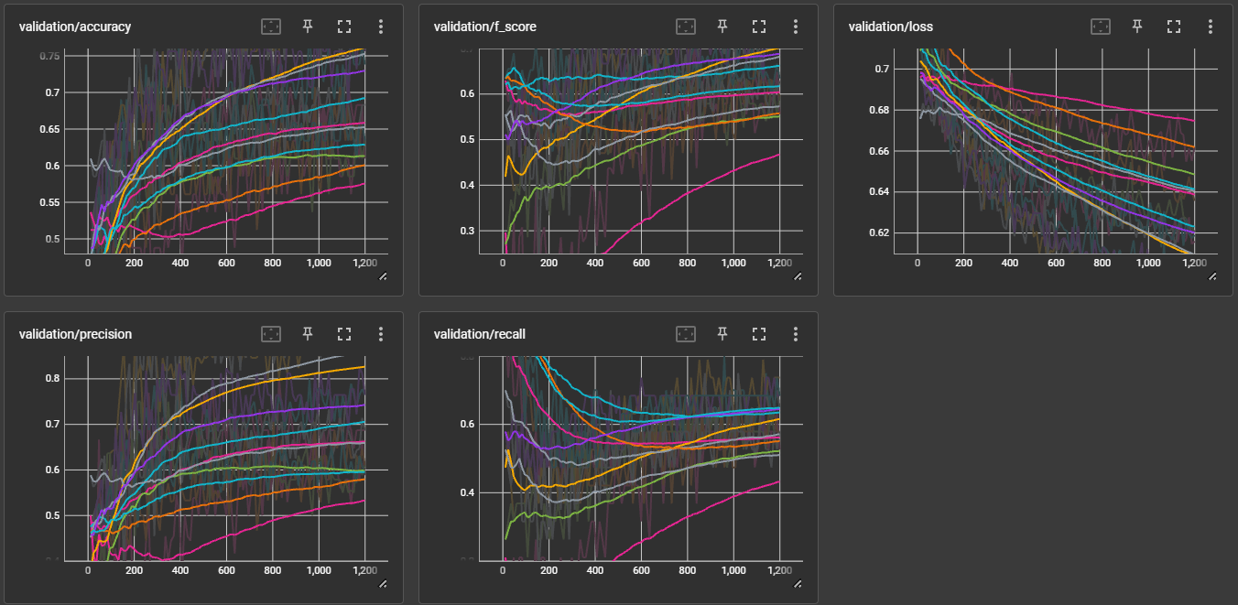
CNN Tests (GoogleNet)
Not overfitting, but bad loss
Bad Level of Accuracy
Learning_rate = 0.0005
Weight_decay = 0.0001
Momentum = 0
Batch_size = 32
Epochs = 100
Early_stopping=5
Not enough value of precision
Bad Value of Recall

Slide 15
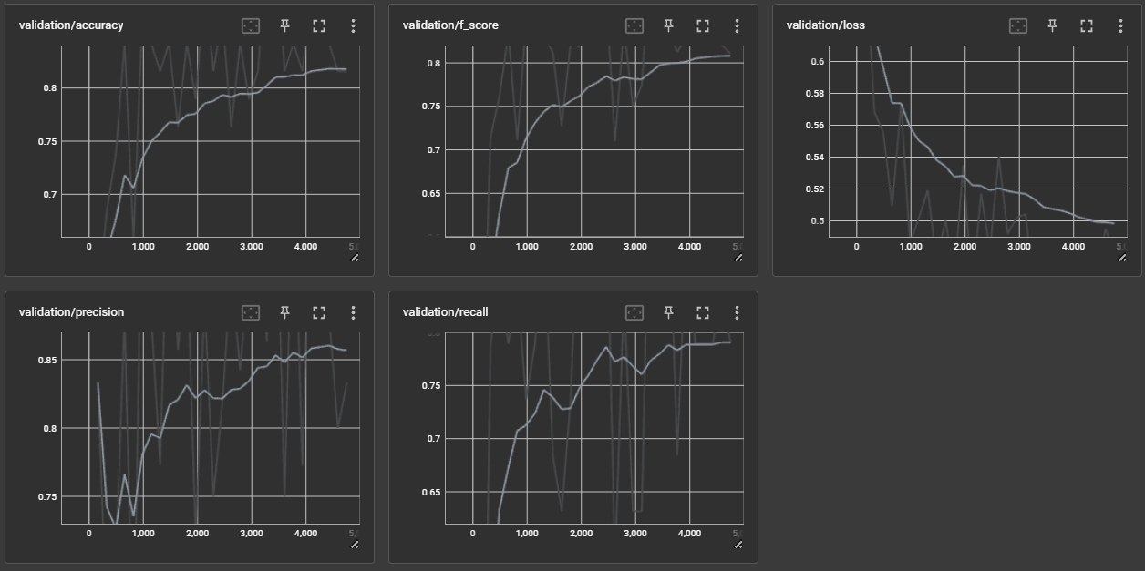
SlowFast Test with the new Dataset
Better values of loss
Better values of accuracy
Learning_rate = 0.001
Weight_decay = 0
Momentum = 0
Batch_size = 2
Epochs = 125
Better values of precision
Better values of recall

Slide 16
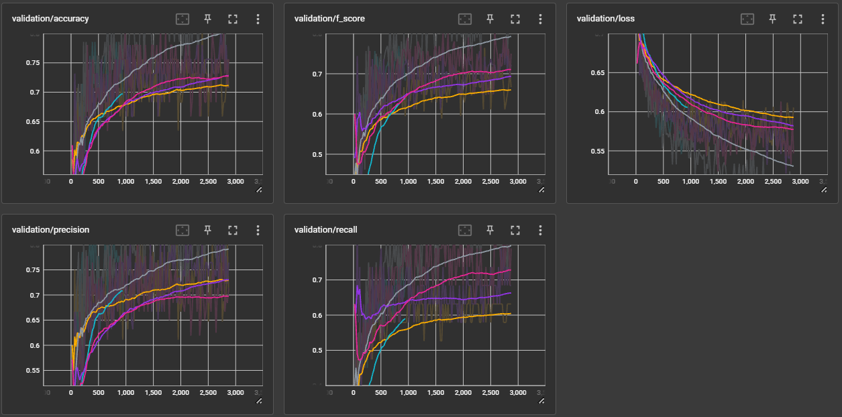
SlowFast K-fold X-validation
Descending loss, but not quite low
Normal levels of accuracy
Learning_rate = 0.000015
Weight_decay = 0
Momentum = 0
Batch_size = 16
Epochs = 100
Early_stopping=5
Normal levels of precision
Normal values of recall

Slide 17
Choice of the model
The results obtained are worse than the test carried out before the total augmentation of the dataset, but they certainly represent a more reliable result having carried out a cross validation
For this reason it was decided to deliver one of these latest models to solve the problem of classification.

Slide 18
Test phase and policy of detection
Number of frames
Expected time of detection
Extra finishing touch
32 frames analyzed by the network togheter
On a video of 24FPS, about 4 second to detect a real fire
Detect for special types of video:
Fire if there are only 32 or 64 frames to analyze and they are fire
Fire if the ending 2 x 32 frames of a video are fire

Slide 19


Thanks
For the attention

Slide 20
Web Resources
To augment the dataset:
APA: Aremu, T., Zhiyuan, L., Alameeri, R., Khan, M., & Saddik, A. E. (2023). SSIVD-Net: A Novel Salient Super Image Classification & Detection Technique for Weaponized Violence.
Youtube Videos. https://www.youtube.com/
Pixabay Videos, https://pixabay.com/it/
Storyblocks Videos, https://www.storyblocks.com/

